Slide 1
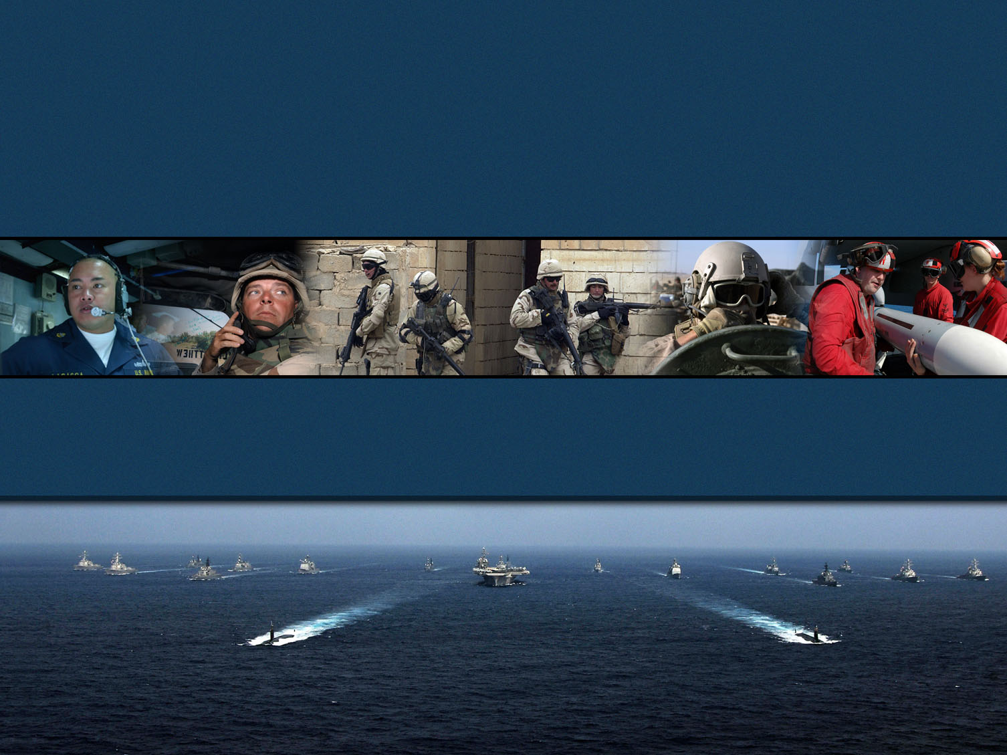


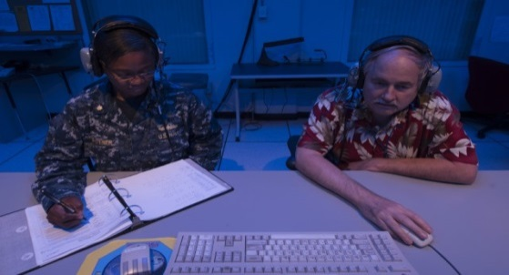
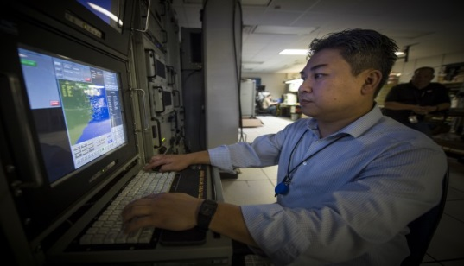
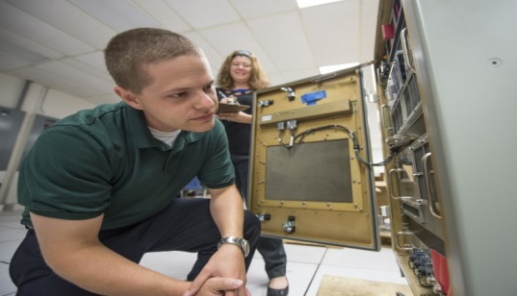
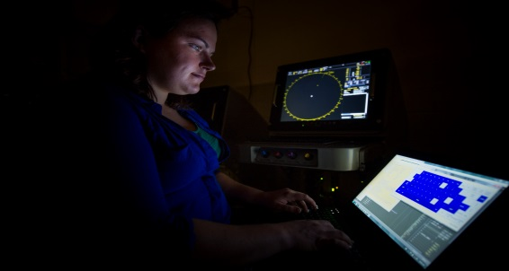
Combat Direction Systems Activity, Dam Neck
Commander Andrew J. Hoffman
Commanding Officer
Command Overview
21 September 2016
Distribution Statement A: Approved for public release
Notes:
Good Morning. I am honored to be here today to tell you a little bit about the Naval Surface Warfare Center Dahlgren Division and the role we play in national defense and in transitioning technology from the laboratory to the warfighter.

Slide 2
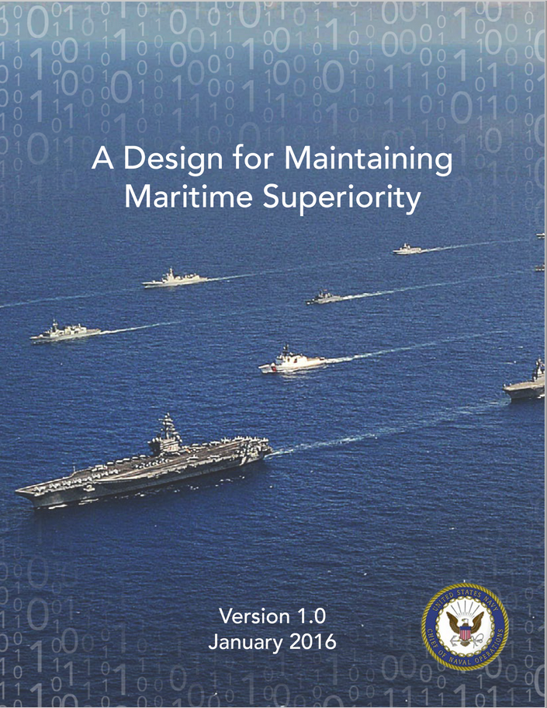
Navy’s Design for Maritime Superiority
Recent Headlines
US warship possibly targeted by Yemen rebels for a third time
(FOXNEWS 16 OCT 16) … Lucas Tomlinson
a U.S. defense official said multiple missiles were fired at three ships patrolling international waters at around 3:30 p.m. ET. U.S. Chief of Naval Operations Adm. John Richardson appeared to confirm that assesment, telling reporters the vessels seemed "to have come under attack in the Red Sea, again from coastal defense cruise missiles fired from the coast of Yemen.“
U.S. military strikes Yemen after missile attacks on U.S. Navy ship
(REUTERS 13 OCT16) … Phil Stewart
WASHINGTON The U.S. military launched cruise missile strikes on Thursday to knock out three coastal radar sites in areas of Yemen controlled by Iran-aligned Houthi forces, retaliating after failed missile attacks this week on a U.S. Navy destroyer, U.S. officials said.
Navy Secretary Mabus Praises USS Nitze Action In Red Sea
(WVEC ABC NORFOLK 13 OCT 16) ... Mike Gooding
NEWPORT NEWS, Va. – Hours after the USS Nitze launched retaliatory Tomahawk cruise missile strikes against Iran-backed Houthi rebel radar sites in Yemen, the Navy's top civilian leader had high praise for the destroyer's crew
N. Korean Missile Launch Fails As Reagan Pays Port Call To Busan
(STARS AND STRIPES 16 OCT 16) ... Kim Gamel
SEOUL, South Korea – North Korea tried but failed to fire an intermediate-range missile, U.S. and South Korean officials said Sunday.
.
“Our competitors are moving quickly, and our adversaries are bent on leaving us swirling in their wake”

Slide 3
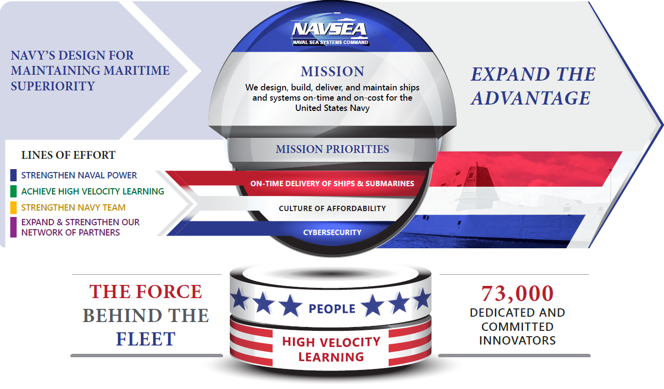
NAVSEA Strategic Framework

Slide 4
Roles of the Warfare Centers
To Make Naval Technical Programs Successful – Warfare Centers safeguard the technical success of Naval programs by providing customers with unbiased technical advice.
To Help Determine and Develop the Capabilities that the Navy and Marine Corps Need – We are an integral part of the leadership’s decision making process in our roles as government trusted technical advisors.
To Verify the Quality, Safety, and Effectiveness of Platforms and Systems – As trusted technical agents, Warfare Centers exercise technical authority through rigorous systems engineering processes to promote the safety and effectiveness of our ships and systems.
To Help Design, Develop, and Field Solutions for Urgent Operational Fleet Needs – The Navy and Marine Corps are our first priority, and we pride ourselves on our ability to deliver an array of responsive options and services for warfighter needs.
To Provide a Bridge Between Warfighters and the Technical Community – We work with the warfighter to understand their operational needs and translate them into requirements that the technical community can address.
Providing critical technical expertise to ensure
current and future program success and fleet readiness
Notes:
Slide demonstrates unique mission, roles & responsibilities of Warfare Centers.
We perform vital, inherently governmental functions across the warfare system life-cycle, are stewards of technical capabilities and critical knowledge, and fill a vital role in bridging the gap between military problems and technical feasibility.
We bridge the early research and concept development with technology development, transition and ISE support to the fleet.
We fulfill our role of smart buyer role by applying necessary end-to-end analysis, development science and engineering support, TDA functions and T&E.

Slide 5
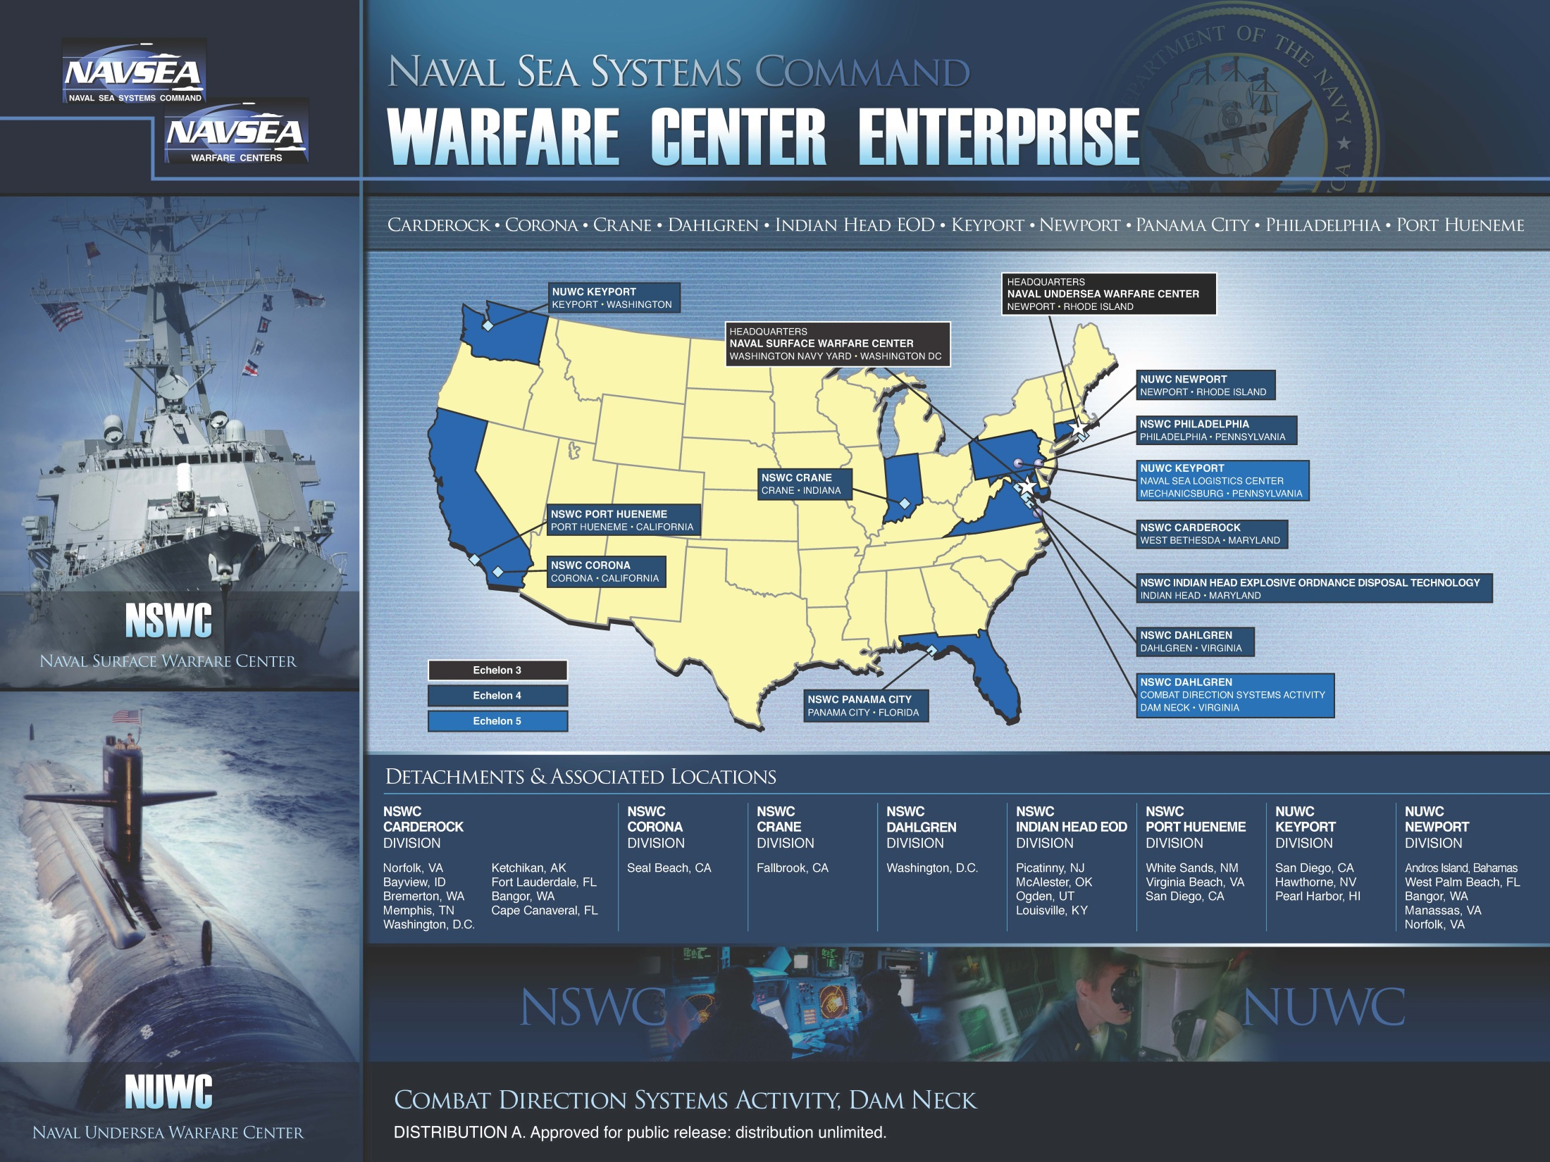

Slide 6
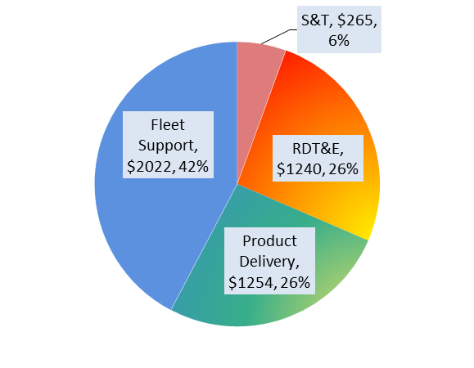
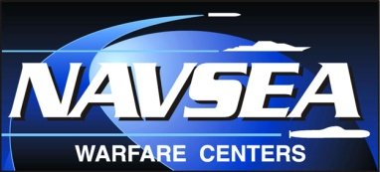
What We Do for the Program Offices/Fleet
Navy In Planning
Navy In Construction
Navy In Operation
S&T
R&D
T&E
Product
Delivery
Fleet
Support
Basic Research
Applied Research
Technical Risk Assessments
Sensor, System, & Missile Performance, Quality, Reliability, and Evaluation/Assessment
Element and Combat System Certification
National/Global Scientific Leadership
Rapid Prototyping
Environmental Testing
Tests @ Ranges/Major Facilities
Technology
Refresh
Modeling and Simulation
Foreign Comparative Testing
Installs
Modernization
& Alterations
Technology/
Obsolescence Management
Patents
Human Systems Integration
Metrology & Test, Measurement & Diagnostic Equipment (TDME)
FY15 Reimbursable
Funding ($M)
Analysis of Alternatives
Quantitative Fleet Feedback and Pre-Deployment Certification
Depot Maint
Repairs
Cost-Performance Tradeoffs
Product Assembly
Systems Training
Onboard Tech Assists
Integrated Logistics Support
Distance Support
Information Assurance & Cyber Security
Integration and Interoperability
Providing technical expertise across multiple portfolios
in multiple warfare areas.
Notes:
6
6
S&T: The WCs have a small but important S&T portfolio. S&T involvement leverages our technical expertise, helps to transition technology into Programs of Record and helps develop our workforce by providing opportunities to work on cutting edge technologies. Our S&T investments are aligned with ONR’s Naval S&T Plan and objectives in the SWE S&T Plan.
R&D and T&E: WC Divisions serve as the technical arm of the NAVSEA PEOs/Directorates. WC Divisions partner with the PEOs to provide –high, -medium, -low risk technical solutions; NAVSEA Warfare Center technical contributions underpin almost all program-level milestone achievements.
Product Delivery: The NAVSEA WCs provide technical and logistics support to the PEOs to deliver products to the Fleet.
Fleet Support: The preponderance of our workload is keeping platforms/systems operationally available and ready for tasking. To accomplish this work, funding flows through the PEOs and directly from the Fleet.

Slide 7
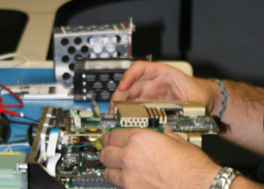
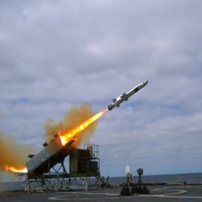
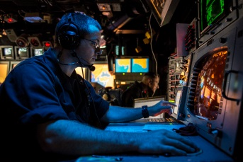
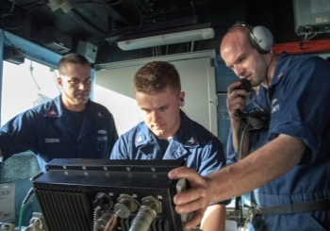
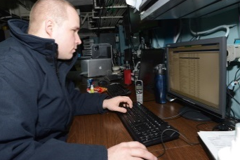
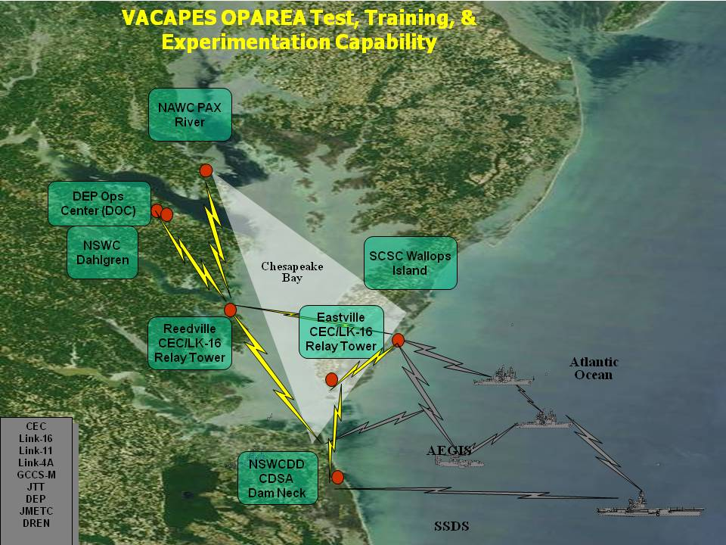
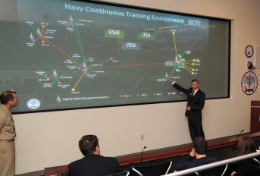
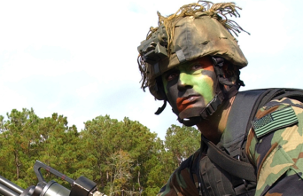
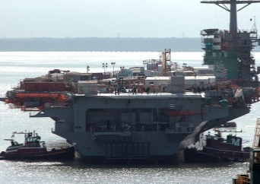
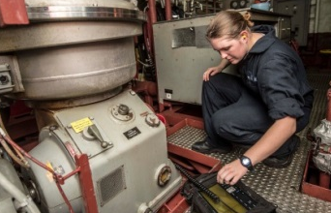
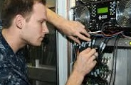
Expanding Warfare Center Capabilities to the Waterfront
The Navy's Operationally Relevant Test, Training and Experimentation Environment
Hardware/Software,
Network Engineering
Systems Safety
> 50% of US Navy & Joint
Forces Within 30 Minutes
Test and Evaluation
Systems Safety
Integrated Training
Cybersecurity Engineering
Modeling and Simulation
Rapid Response Engineering
Lifecycle Engineering
Over 50% of US Navy & Joint
Forces within 30 Minutes
System Engineering
Integrated Logistics
Notes:
The Dahlgren Division is a naval Research, Development, Test and Evaluation (RDT&E) institution founded in Naval Warfare, focused to meet the needs of the Department of Navy (DoN), which also supports Joint and National initiatives that have naval implications. Our Role:
Help the Navy determine and develop the capabilities it needs.
We play an I ntegral part in the decision-making process as technical advisors.
Verify the quality, safety, and effective of the Navy’s ships and systems utilizing rigorous systems engineering processes.
Help design, develop and field solutions for urgent operational Fleet needs..
We pride ourselves on our ability to deliver an array of responsive options and service for Fleet needs.
Work closely with the warfighter to fully understand operational challenges and requirements.
Provide a bridge between warfighters and the technical community.
We work with the fleet to understand their operational needs and translate them into requirements that the technical community can understand.
This critical linkage results in delivery of effective, affordable and timely warfighting capabilities to our men and women in uniform.

Slide 8
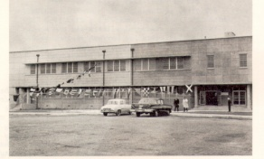
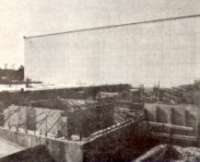
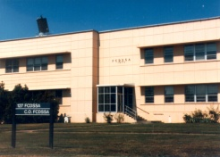
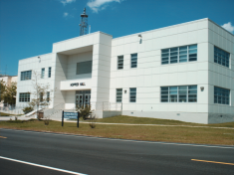
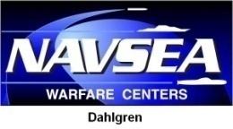



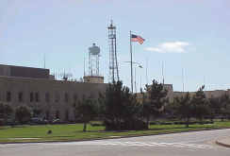

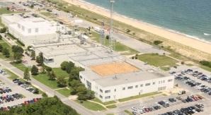
CDSA History
1963
1971
1992
2000
Present
Fleet Computer Programming Center
Fleet Combat Direction System Support Activity (FCDSSA)
East Coast Operations
Combat Direction Systems Activity
Command
Detachment
NSWC PHD
Command
NSWC DD
COMTRALANT (63-69)
CINCLANTFLT (69-71)
Bldg 127S construction
First addition
Taylor Hall
1984
Hopper Hall
1994
2000 CDSA Command Established
2000 CDSA Aligned with NSWC DD as Echelon 5
1991 BRAC – Naval Sea Combat Systems Engineering Station
(SEABAT) Integrated
1992 FCDSSA becomes Detachment under PHD
1995 BRAC – In-Service Engineering East Coast Detachment
(NISEAST) (1998) Integrated
M&S: Radar Environment Simulation Systems
Battle Force Tactical Training
Warfighter Support
Rapid Engineering
Integrated Training (Naval, Joint, Coalition)
Readiness
Develop, Field, & Maintain Computer Programs
ISEA/SIA: Combat Systems (SSDS),
Radar Distribution Systems (ASDS)
T&E: TADIL, CEC, Live Exercises ,
NTDS Model 4
Combat Systems
Integrated Training Systems
Networked Sensors and Systems
Interoperability
Software Engineering
Hardware Engineering
Systems Engineering
Notes:
LAB REALIGNMENT (OVER D 92)
Naval mine warfare and engineering activity
NMWEA & SEABAT to come to
Dam Neck
All parts of PHD in Naval Surface
Warfare center
BRAC 93
NMWEA goes to Panama City
SEABAT to Naval Undersea Warfare
Center, Newport, RI
1994 - SEABAT Engineers on board
BRAC 95
BRAC’ed to the Fleet Combat Training
Center
Retained alignment with PHD as detachment
(East Coast Ops Dam Neck Detachment, PHD)
1998 - NISEAST ONI/CNSG Engineers on board
RESS Radar Environment Simulator System
ERESS Enhanced Radar Environmental Simulation System

Slide 9
NSWC Dahlgren Division Integrated
Technical Departments
A Department
Strategic &
Computing Systems
Department
B Department
Electromagnetic &
Sensor Systems
Department
E Department
Gun & Electric
Weapon Systems
Department
H Department
Weapons Control &
Integration
Department
R Department
Readiness &
Training Systems
Department
V Department
Warfare Systems
Engineering &
Integration
Department
SLBM
Re-entry systems
Common Computing Platforms & Operating Environments
Cyber Warfare Engineering
Anti-Tamper / SCRM
Mission Assurance
Cybersecurity
Quantum Cyber Group/ Scientometrics
TSOA/RIG
Radar Systems
Electronic Warfare
Sensor Integration
Electromagnetic Environmental Effects/ Topside Design
Spectrum Mgt/ RTSO
Chemical, Biological, Radiological Defense Systems
EM S&T/ Metamaterials
Railgun (Launcher, Projectile, Power)
Directed Energy Programs
Gun Weapon Systems
PRTR/Range Operations
Weapons Control Systems (LCS, USW, Tomahawk…)
Missile Integration & Launchers
Weapons Effectiveness
Expeditionary Platform Integration
Unmanned Systems
Battle Mgt System
Asymmetric Capability Development/ Disruptive Technologies/ NCKN / IWO
Fleet Support
Integrated Training Systems
Computer Program Builds & Installs
Integrated Logistics
Special Sensors
System Safety
Cyber Readiness/ T&E
Combat System Engineering
Combat System Certification
Combat System T&E
Mission/Force/ SoS Analysis & Engineering
Interoperability
C2 Systems
Cost Analysis
HSI
Code OME
Mission Engineering
& Analysis
Directorate
Acquisition Studies (CBAs, AOAs, ICDs)
Fleet Gaps, Assessments, and Operational Solutions
SoS System Level Requirements
Denotes Dam Neck Site
Notes:
Broad spectum of programs supporting our mission goals.
A premier naval scientific and engineering institution.
NSWCDD’s mission is to understand technical dimensions of military problems and a systems approach to a responsible solution.
Today, new technological advances are being harnessed to build the U.S. Fleet of the future, and NSWCDD scientists and engineers are in the forefront of research and development, lending their knowledge, expertise, and innovations so that our Navy retains its place as the number one fleet in the world.

Slide 10
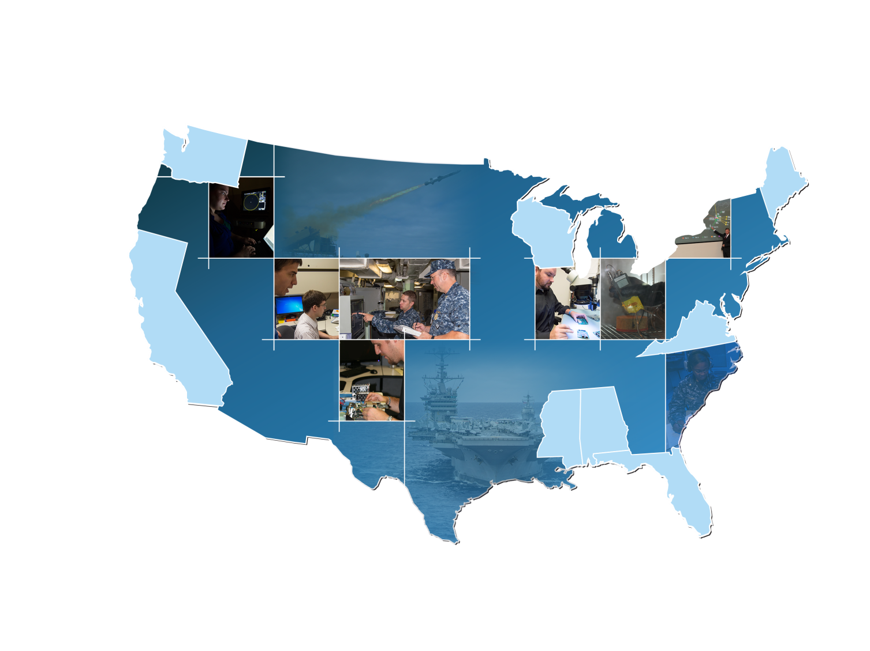
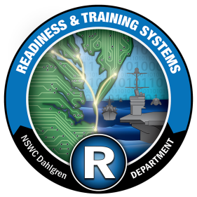
CDSA Fleet Support Footprint
Washington
Everett
AEGIS Support
Wisconsin
Marinette
LCS Waterfront Support
Maine
Bath
SUPSHIP AEGIS Support
Virginia
Norfolk, Chesapeake, Newport News, Suffolk, Virginia Beach, & Wallops Island
IWS 10-SUPSHIP Support
  1 Civilian
SURFLANT-SQQ-89
  1 Civilian
NIOC
  1 Civilian
Joint IO Range
  6 Civilians
JLVC/JKO (Joint Staff J7)
  23 Civilians
IWS 5B-SQQ-89 Team
  1 Civilian
Science Advisors (NAVIFOR/ MARFORCOM)
  2 Civilians
Test & Evaluation (COMOPTEVFOR)
  3 Civilians
NEIC Support
  1 Civilian
AEGIS Support (Wallops Island)
  2 Civilians
California
San Diego & Oceanside
BFTT/SQQ-89/SSDS Waterfront Team
AEGIS Modernization Team (Naval Base)
Readiness and Training Systems Department (R)
Virginia
Dam Neck & Dahlgren
C6ISR Systems
Integrated Training Systems
Combat Systems Readiness
Systems Safety Engineering
506 Civilians & Military (292 DN, 225 DL)
110 Contractor Personnel (82 DN, 28 DL)
Mississippi
Pascagoula
SUPSHIP AEGIS Support
Alabama
Mobile
LCS Waterfront Support
Florida
Mayport
LCS Waterfront Support
Notes:
San Diego, California (NAVBASE San Diego)
AEGIS Modernization Team (AMT) Facility
2680 Woden Street, Bldg. 322
San Diego, CA 92136
San Diego, California (NAVBASE Point Loma)
4635 Pacific Highway, Bldg. 3
San Diego, CA 92110
Pascagoula, Mississippi (Huntington Ingalls Shipyard) – 1 Civilian
SUPSHIP AEGIS Support
SUPSHIP Gulf Coast ADMIN Building #1, 2nd Floor Security
1000 Jerry St Pe Highway
Pascagoula, MS 39568
Bath, Maine (SUPSHIP) – 1 Civilian
SUPSHIP AEGIS Support
574 Washington Street
Bath, ME 04530
Mayport, Florida (NAVSTA Mayport) – 1 Civilian
LCS Waterfront Support
1488 Massey road, Building 2020
Jacksonville, FL 32228
Mobile, Alabama – 1 Civilian
LCS Waterfront Support
Austral USA
Navy Administration Building
200 Addsco Road
Mobile, Al 36602
Marinette, WI (Fincantieri Marinette Marine Shipyard) – 1 Civilian
LCS Waterfront Support
1600 Ely Street
Marinette, WI
Chesapeake, Virginia (Lockheed Martin Facility) – 1 Civilian
SQQ-89 Support
500 Woodlake Drive, Suite 2
Chesapeake, VA 23320
Norfolk, Virginia – 21 Civilians
- Naval Operations Base
- Joint Information Operations Range – 6 Civilians
- Navy Warfare Development Command (NCTE) – 9 Civilians
- Naval Support Activity Hampton Roads
MARFORCOM Science Advisor – 1 Civilian
COMOPTEVFOR Team – 3 Civilians
- NAVSTA Norfolk - 2 Civilians
AEGIS Modernization Team
Suffolk, Virginia (Joint Staff J7 Suffolk Complex) – 19 Civilians
116 Lake View Parkway
Suffolk, VA 23435-2697
- Joint Live Virtual Constructive / Joint Knowledge Online
Suffolk, Virginia (Navy Information Dominance Forces) – 1 Civilian
115 Lake View Parkway
Suffolk, VA 23435-2697
NAVIDFOR Science Advisor
Virginia Beach, Virginia – 1 Civilian
Navy Expeditionary Intelligence Command
Engineering Services

Slide 11
CDSA FY16 Numbers
Business Baseline
Direct $220 M; Indirect $12.5 M
Total Contracting Effort
Buildings Occupied
Total Square Feet
$130 M
11
181,045
Civilian Staffing – data as of 28 July 2016
Business Base in $M
S&E Disciplines
Employee End-strength (Civ/Mil)
543/ 37
Average Age of Workforce
47
Workforce Education
Bachelors 260
Masters 139
Doctorate 4
Scientist & Engineers
Cyber Engineering Workforce
325
110

Slide 12
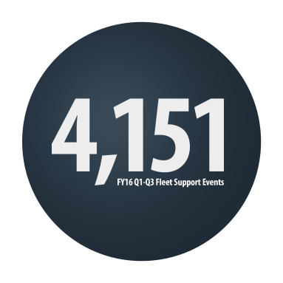
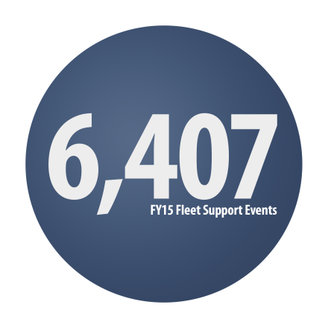
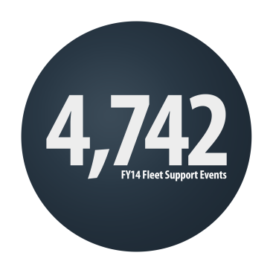
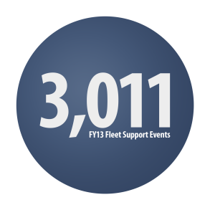
Fleet Support in Q1-Q3 FY16
Touch Points
BFTT 831
Surface ASW 829
ASDS 109
SSDS/ACDS 177
Special Sensors 1575
Aegis (S/W) 373
BMD (S/W) 176
LCS 81
Total 4151
FY16 Q1-Q3
4151 DISCRETE FLEET
SUPPORT EVENTS Q1-Q3 FY16
Started Capturing Data in FY13

Slide 13
NAVSEA Warfare Center Fleet
Engagement Community of Practice
Commander Naval Surface Warfare Center
RDML T DRUGGAN
Naval Warfare Center
Executive Director
Mr. D. MCCORMACK, SES
Commander Naval Undersea Warfare Center
RDML M DELTORO, III
Warfare Center Division
Commanding Officers and Technical Directors (SES)
NAVSEA Warfare Centers Fleet Engagement Community of Practice
OPNAV
Warfare Center CTOs
(Prototype & Demos)
Naval Warfare Center
Mission Directors (SL)
SUW, MIW, USW
Naval SYSCOMs
NAVSEA
(Tech Warrant Holders)
DASN RDT&E
Secretariat
Warfare Center Divisions Core Team
Fleet Commands & WDCs
Lines of Effort
Waterfront Support
Mission Engineering
Cross Warfare Center Analysis Team(s)
Fleet
Wargaming
Training
Fleet Exercises
& Assessments
Fleet WIPs
I&I
WCB & ICP
Across Mission Areas
CDSA Participation in Green

Slide 14
NSWC Dahlgren Division Integrated
Technical Departments
A Department
Strategic &
Computing Systems
Department
B Department
Electromagnetic &
Sensor Systems
Department
E Department
Gun & Electric
Weapon Systems
Department
H Department
Weapons Control &
Integration
Department
R Department
Readiness &
Training Systems
Department
V Department
Warfare Systems
Engineering &
Integration
Department
SLBM
Re-entry systems
Common Computing Platforms & Operating Environments
Cyber Warfare Engineering
Anti-Tamper / SCRM
Mission Assurance
Cybersecurity
Quantum Cyber Group/ Scientometrics
TSOA/RIG
Radar Systems
Electronic Warfare
Sensor Integration
Electromagnetic Environmental Effects/ Topside Design
Spectrum Mgt/ RTSO
Chemical, Biological, Radiological Defense Systems
EM S&T/ Metamaterials
Railgun (Launcher, Projectile, Power)
Directed Energy Programs
Gun Weapon Systems
PRTR/Range Operations
Weapons Control Systems (LCS, USW, Tomahawk…)
Missile Integration & Launchers
Weapons Effectiveness
Expeditionary Platform Integration
Unmanned Systems
Battle Mgt System
Asymmetric Capability Development/ Disruptive Technologies/ NCKN / IWO
Fleet Support
Integrated Training Systems
Computer Program Builds & Installs
Integrated Logistics
Special Sensors
System Safety
Cyber Readiness/ T&E
Combat System Engineering
Combat System Certification
Combat System T&E
Mission/Force/ SoS Analysis & Engineering
Interoperability
C2 Systems
Cost Analysis
HSI
Code OME
Mission Engineering
& Analysis
Directorate
Acquisition Studies (CBAs, AOAs, ICDs)
Fleet Gaps, Assessments, and Operational Solutions
SoS System Level Requirements
Denotes Dam Neck Site
Notes:
Broad spectum of programs supporting our mission goals.
A premier naval scientific and engineering institution.
NSWCDD’s mission is to understand technical dimensions of military problems and a systems approach to a responsible solution.
Today, new technological advances are being harnessed to build the U.S. Fleet of the future, and NSWCDD scientists and engineers are in the forefront of research and development, lending their knowledge, expertise, and innovations so that our Navy retains its place as the number one fleet in the world.

Slide 15
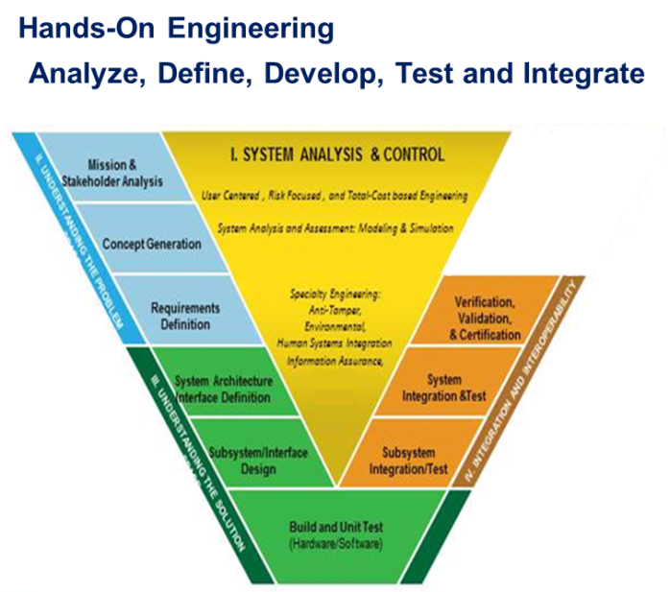
A32
Ship Self-Defense System Computing
Vision
Provide Ship Self Defense System-equipped platforms with an advanced computing, and networking environment that is hardened, resilient, and scalable. This Integrated Combat System will support platforms as they deter conflict, respond to crises, defeat aggression, and protect the maritime commons throughout the levels of command (Strategic, Operational, and Tactical)
Mission
Provide development and implementation-focused, hands-on engineering for the Ship Self Defense System and other emergent Detect-Track-Engage Integrated Combat Systems, as directed.
Technical Capabilities
Current Design Efforts
TI-12H
TI-16
SSDS Operating Environment
Cyber efforts
DD23 – Force Level Warfare Systems Engineering and Integration
DD24 – Force Level Warfare Systems Interoperability Engineering
Key Functional Capabilities
Combat System Engineering Design, Development & Integration
Government Owned Hardware Design
Government ownership & implementation of Cybersecure OE development
Enabling Affordable Combat System Capability

Slide 16
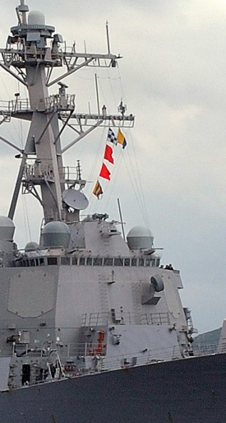
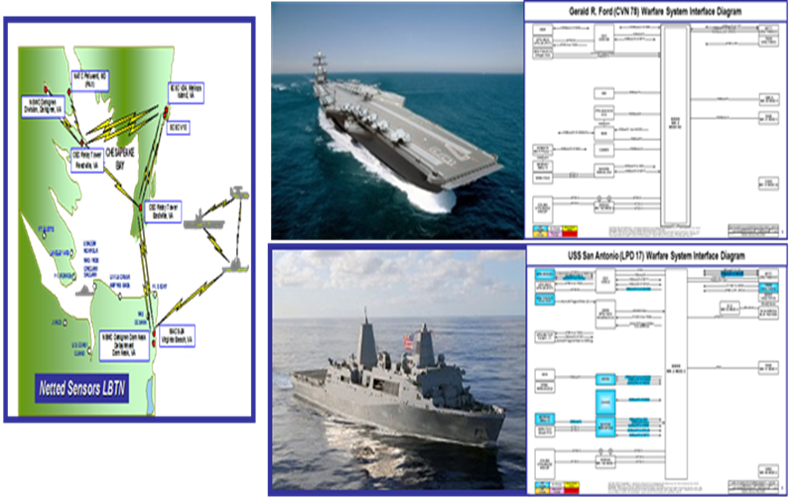
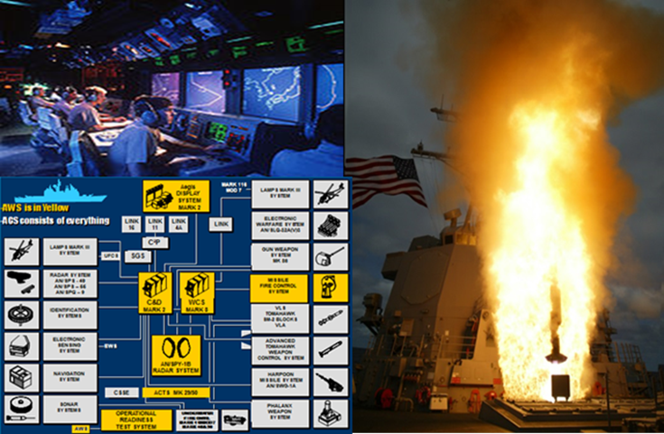
V50 Division
Enterprise Test and Evaluation Division
Mission
Provide combat system, warfare system, and system of systems interoperability test and evaluation expertise for the Surface Navy and Joint Forces by offering innovative and cost effective test solutions across the acquisition lifecycle.
Technical Capabilities
DD04 - Surface Warfare Systems Engineering and Integration RDT&E
DD05 - Surface Combat Systems Engineering and Integration RDT&E
DD06 - Surface Combat Control Systems S&T, RDT&E
DD08 - Surface Warfare System and Force Level Certification/IV&V
DD14 – Expeditionary and Other Weaponry Systems RDT&E
DD35 – Integrated Surface Combat Control Systems Support
Customer Summary
Key Functional Capabilities
IWS 1 - AEGIS
IWS 7 – Future Combat Systems
PMS 420, PMS 501 PMS 505, IWS 8 – LCS / FF
IWS 9 – DD(X)
IWS 10- SSDS
MCSC PMM 111 - COC
MDA – AEGIS BMD
PMS 339 - CIAT
PMS 312, PMS 378 – In-Service and New Construction Aircraft Carriers
PMS 379 – CVN-79
SEA 05 - DIIAC, MTMD
T&E Project Leadership
Combatant System T&E
  T&E Strategy
  Test Plans / Test Articles
  Test Execution / Data Analysis
Combat System Element IV&V
Test Support
  Test and Analysis Tools
  Test Infrastructure
Interoperability Engineering / Test
Combat System Fleet Support
  CPDD / Crew Briefs
  Warfare Systems Engineering
  IWS Enterprise CM
  MTMD M&S
  Mission Engineering
Carrier Support
  Pre/Post Delivery Test/Trials Combat System Engineering

Slide 17

























Diverse Partnerships
Networked in the Hampton Roads Community
Notes:
Snapshot of our current partnerships. Constantly growing. Is representative of how many other organizations work with us to achieve success.
VASCIC: Virginia Advanced Shipbuilding and Carrier Integration Center.

Slide 18
Select FE COP Lines of Effort
Fleet Warfare Improvement Program (WIP): The Fleet WIP LOE will report on the various WIPs and interaction of the WFCs with the WIPs. This LOE will also develop and report best practices that will improve WFCs interaction and relationships in support of the WIPs. This team is to provide updates on future and past interactions in WIPs.
Waterfront Support: This LOE will review and spread WFC best practices in waterfront support to include support for ships, waterfront staffs, NAVSEA shipyards and NAVSEA program managers. This LOE will utilize established mechanisms and create new ones when necessary to engage the Fleet at the waterfront and to provide feedback for improvement to other WFC via the COP. This LOE will also capitalize on these relationships as an informal method to ensure the WFC centers address Fleet needs.
Training- This LOE will review and spread WFC best practices in the area of Fleet training. This LOE will utilize established mechanisms and create new ones when necessary to engage the Fleet in the area of system, unit and operational level training and provide feedback for improvement to other warfare centers via the COP. This LOE will also capitalize on these training relationships as an informal method to ensure the warfare centers address Fleet needs.
For Official Use Only (FOUO)

