Slide 1
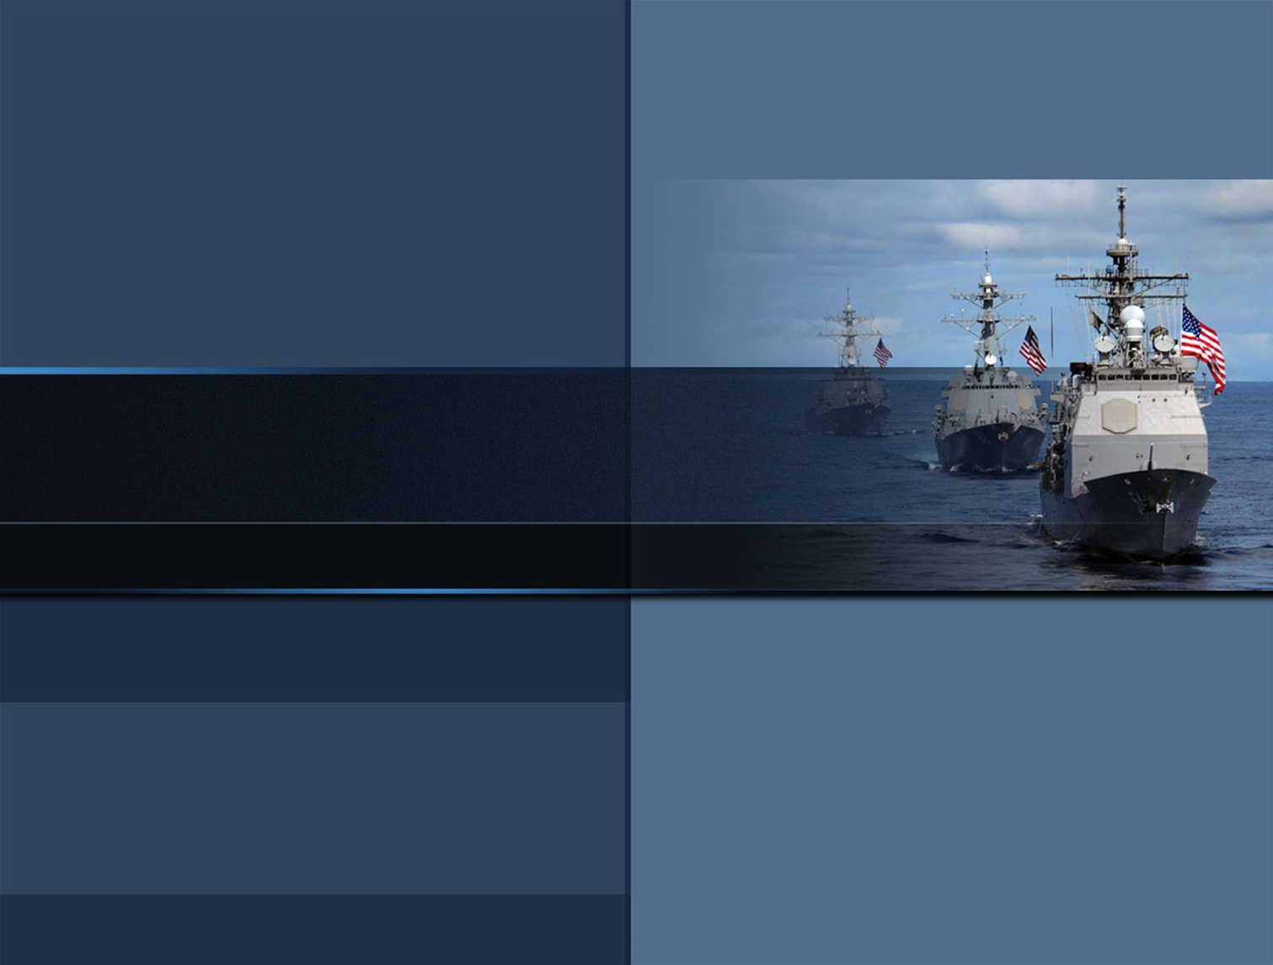


CAPT Brian R. Durant • Commanding Officer
NSWC Dahlgren Division
CAPT Brian R. Durant • Commander
CDR Andrew J. Hoffman • Commanding Officer Combat Direction Systems Activity, Dam Neck
Dennis M. McLaughlin • Technical Director
Naval Surface Warfare Center, Dahlgren Division
Naval Surface Warfare Center, Dahlgren Division
The Leader in Warfare Systems Development and Integration
The Leader in Warfare Systems Development and Integration
Baseline Brief
Readiness & Training Systems Department (R)
Overview
Leo Zaloga
Deputy Department Head
January 2015
Date: 19 October 2016
Distribution A: Approved for Public Release; Distribution is Unlimited
Distribution A: Approved for Public Release; Distribution is Unlimited

Slide 2
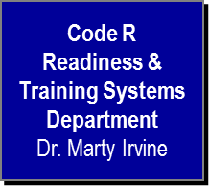
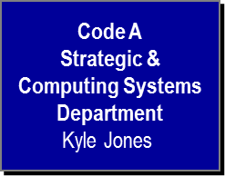
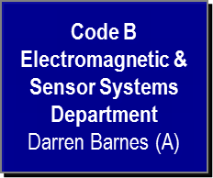
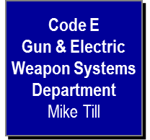

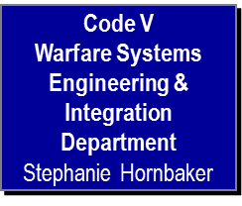
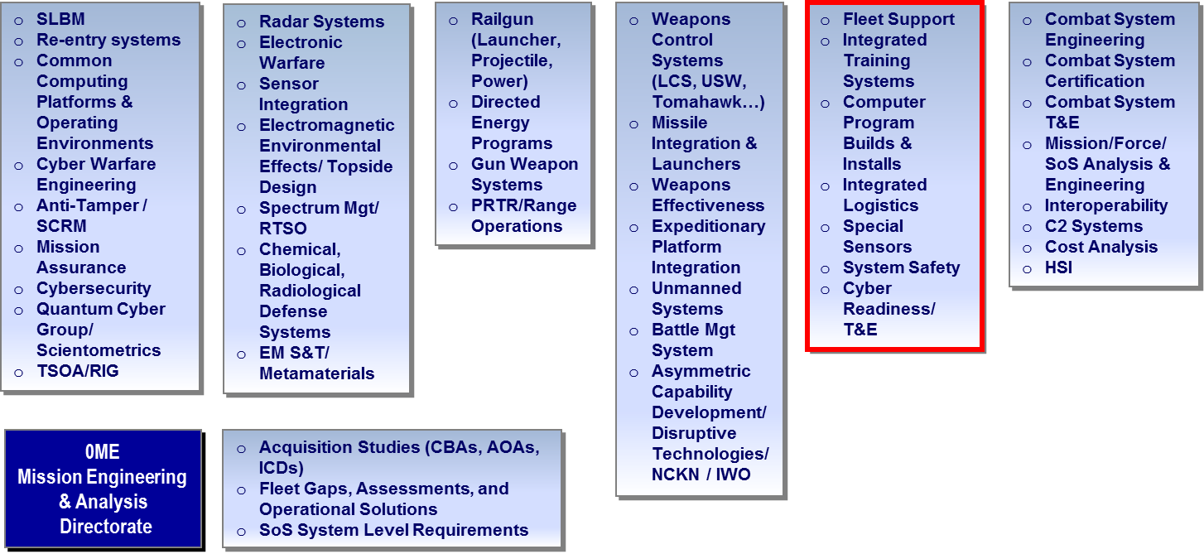
NSWC Dahlgren Division Integrated
Technical Departments
Code H
Weapons Control &
Integration
Department
John Lysher
Notes:
The Dahlgren Division is a naval Research, Development, Test and Evaluation (RDT&E) institution founded in Naval Warfare, focused to meet the needs of the Department of Navy (DoN), which also supports Joint and National initiatives that have naval implications. Our Role:
Help the Navy determine and develop the capabilities it needs.
We play an I ntegral part in the decision-making process as technical advisors.
Verify the quality, safety, and effective of the Navy’s ships and systems utilizing rigorous systems engineering processes.
Help design, develop and field solutions for urgent operational Fleet needs..
We pride ourselves on our ability to deliver an array of responsive options and service for Fleet needs.
Work closely with the warfighter to fully understand operational challenges and requirements.
Provide a bridge between warfighters and the technical community.
We work with the fleet to understand their operational needs and translate them into requirements that the technical community can understand.
This critical linkage results in delivery of effective, affordable and timely warfighting capabilities to our men and women in uniform.

Slide 3
Readiness & Training Systems Department
Department Head (R)
Military Applications Officer (R01)
Deputy Department Head (R02)
Executive Assistant (R09)
Assistant (R029)
DEPARTMENT OPERATIONS
Business Office (R03)
Acquisition Team (R0A)
TDAA (R0C)
Facilities/Infrastructure (R0F)
Information Officer (R0I)
TECHNICAL STAFF
Chief Engineer (R04) (A)
Chief Scientist (R04S)
Readiness Program Office (R05)
Strategic Operations (R06)
C6ISR Systems
R10
Integrated Training Systems
R20
Combat Systems Readiness
R30
Systems Safety Engineering
R40
Special Technologies (R11)
Systems Assessment (R12)
Cybersecurity Engineering & Readiness (R13)
Surface Training Systems (R21)
Tactical Support Engineering (R22)
Distributed Training (R23)
Combat Systems Support (R31)
Data Distribution Systems (R32)
Surface Ship ASW Systems Support (R33)
Combat Systems Software Installation & Integration (R34)
Combat Systems Software Readiness & Sustainment (R35)
Engagement Systems Safety (R41)
Combat Systems Safety (R42)
Platform Systems Integration Safety (R43)
Technology Integration Safety (R44)
Cross-Site
3

Slide 4
FY16 - R Department
Business Baseline
Direct $220 M
Total Contracting Effort
Buildings Occupied
Total Square Feet
$130 M
11
181,045
Civilian Staffing – data as of 28 July 2016
Business Base in $M
S&E Disciplines
Employee End-strength (Civ/Mil)
543/ 37
Average Age of Workforce
47
Workforce Education
Bachelors 260
Masters 139
Doctorate 4
Scientist & Engineers
Cyber Engineering Workforce
325
110

Slide 5
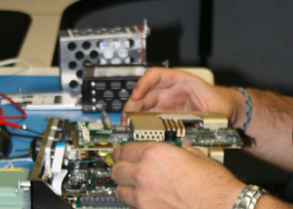
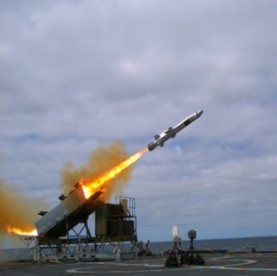
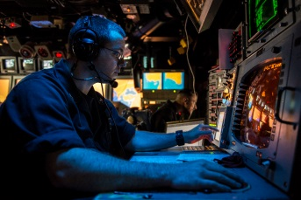
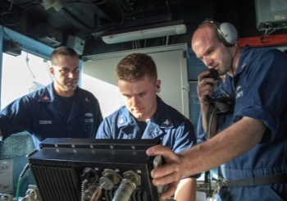
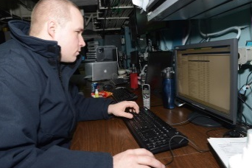
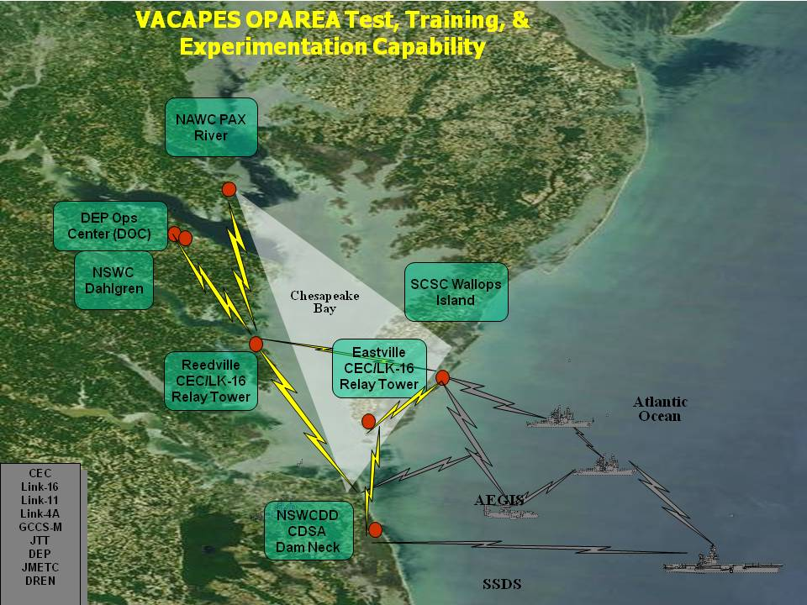
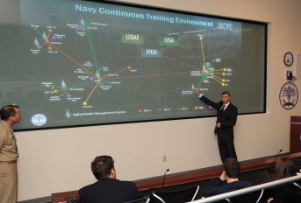
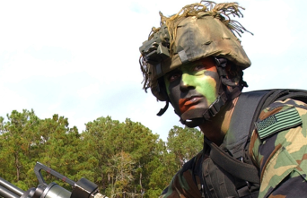
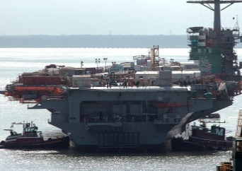
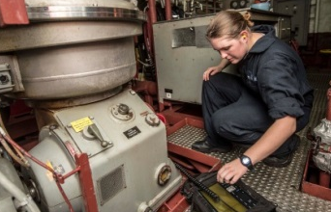
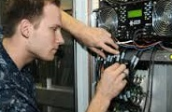
Readiness & Training Systems
Department (R) Unique Capabilities
The Navy's Operationally Relevant Test, Training and Experimentation Environment
Hardware/Software,
Network Engineering
Systems Safety
> 50% of US Navy & Joint
Forces Within 30 Minutes
Test and Evaluation
Systems Safety
Integrated Training
Cybersecurity Engineering
Modeling and Simulation
Rapid Response Engineering
Lifecycle Engineering
VACAPES Operating Area
The Only Test And Training Space In The World Covered
By Land-Based SPS-48, SPS-49, & SPY 1 Radars
System Engineering
Integrated Logistics
Notes:
The Dahlgren Division is a naval Research, Development, Test and Evaluation (RDT&E) institution founded in Naval Warfare, focused to meet the needs of the Department of Navy (DoN), which also supports Joint and National initiatives that have naval implications. Our Role:
Help the Navy determine and develop the capabilities it needs.
We play an I ntegral part in the decision-making process as technical advisors.
Verify the quality, safety, and effective of the Navy’s ships and systems utilizing rigorous systems engineering processes.
Help design, develop and field solutions for urgent operational Fleet needs..
We pride ourselves on our ability to deliver an array of responsive options and service for Fleet needs.
Work closely with the warfighter to fully understand operational challenges and requirements.
Provide a bridge between warfighters and the technical community.
We work with the fleet to understand their operational needs and translate them into requirements that the technical community can understand.
This critical linkage results in delivery of effective, affordable and timely warfighting capabilities to our men and women in uniform.

Slide 6
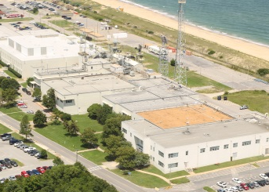
Readiness & Training Systems
Department (R) Unique Capabilities
The Navy's Operationally Relevant Test, Training and Experimentation Environment
Hardware/Software,
Network Engineering
CDSA Dam Neck
> 50% of US Navy & Joint
Forces Within 30 Minutes
Test and Evaluation
Integrated Training
Cybersecurity Engineering
Modeling and Simulation
Rapid Response Engineering
Lifecycle Engineering
VACAPES Operating Area
The Only Test And Training Space In The World Covered
By Land-Based SPS-48, SPS-49, & SPY 1 Radars
System Engineering
Integrated Logistics

Slide 7
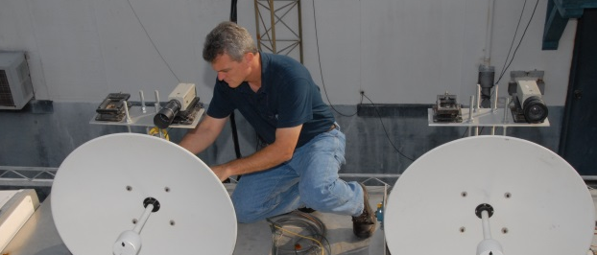


R10 Division
C6ISR Systems Division
Vision
To be a world class provider of rapid response engineering focused on Global
Maritime Security Operations. We accomplish this through the utilization and
development of advanced technologies and the application of Systems of
Systems Engineering principles.
Technical Capabilities
DD08 – Surface Warfare System and Force Level Certification/IV&V
DD21 – National Response Missions, Including Homeland Security
and Defense
DD27 – Tactical Common Data Communications Systems Integration
and Interoperability
DD35 – Integrated Surface Combat Controls Systems Support
DD36 – Integrated Training Systems
DD38 – Jt Command and Control Systems Integration and Architecture Dev.
Customer Summary
Cybersecurity Engineering Program
Marine Corps Systems Command
PEO IWS – PEO IWS 1/2/3/7/10
PEO LCS - PMS 501/505/515, PEO IWS 8
PEO Carriers - PMS 312, PMS 378/379
NIOC Norfolk
SEA05
ASN RDA
Intelligence Systems Program
Office of Naval Intelligence
Naval Research Laboratory
Navy Cyber Warfare Development Group, Suitland
Commander, Naval Submarine Forces
Commander, Submarine Force U.S. Pacific Fleet
Commander, Tenth Fleet / Fleet Cyber Command
OPNAV N2/N6
PMS-435
Expeditionary Technologies Program
PMS 408
Marine Corps Systems Command
Navy Expeditionary Intelligence Command
USCG
Office of Naval Research
NAVAIR PMA 205
Key Functional Capabilities
Expeditionary Maritime Domain Awareness Systems
Signals Intelligence Collection Systems
Cyber Security Engineering
Cyber Warfare Test and Evaluation
Rapid Response Engineering Solutions
Electronic Component Design and Development for Harsh Environments
Combat System Hardware Design and Development
Fleet and Operational Commander Engineering Support

Slide 8
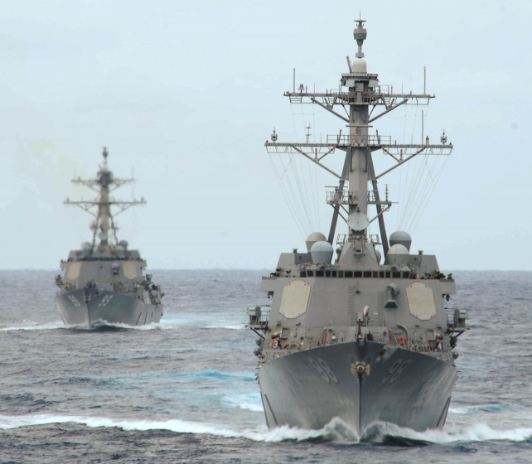
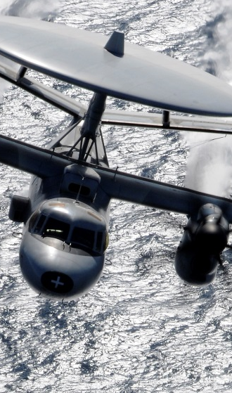
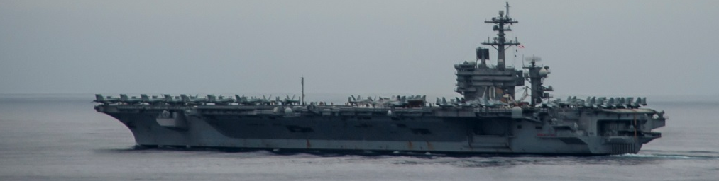
R20 Division
Integrated Training Systems Division
Vision
Leader in Research, Development, Engineering, Modernization and Sustainment
of Navy, Joint and Coalition Integrated and Embedded Surface Training Systems
Technical Capabilities
Customer Summary
DD23 – Force Level Warfare Systems Engineering and Integration
DD24 – Force Level Warfare Systems Interoperability Engineering
DD36 – Integrated Training Systems
DD38 – Joint C2 Systems Integration & Architecture Development
PEO IWS 1 – Interoperability, NTDLIOTS, CST, BFTT, ACTS, ATD
PEO IWS 2 – DBR Training Interface Development
PEO IWS 4 – FMS Training, Integration & Interoperability
PEO IWS 6 – CEC
PEO IWS 10 – SSDS Training Systems & Link Interoperability
PMS 326 – German FMS
NIPO – MTMD/M&S
DDJT, JS J7 – JKO, Environment Operations, Environment Architecture & Cyberspace Environment
ONR – A2AD
Key Functional Capabilities
Embedded Training Systems Design, Development, Implementation,
Testing, Integration, Interoperability and Sustainment
Combat System Engineering, Integration, Test & Evaluation (T&E) and
Distance Support

Slide 9
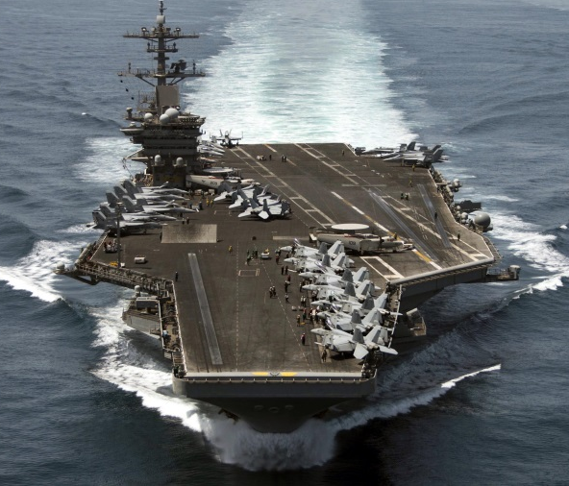
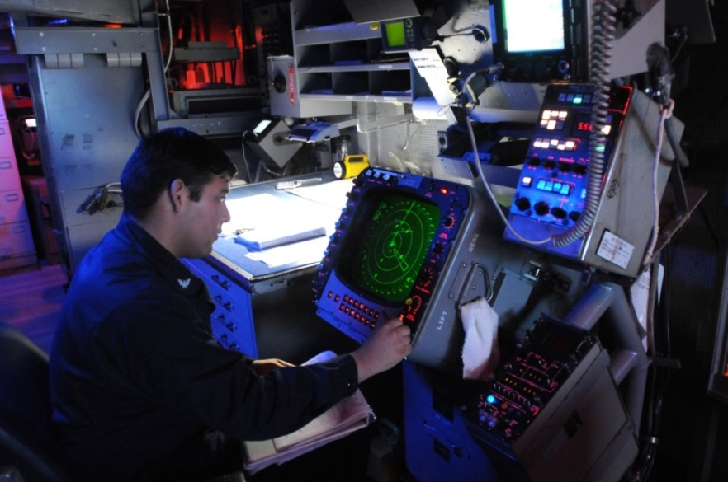
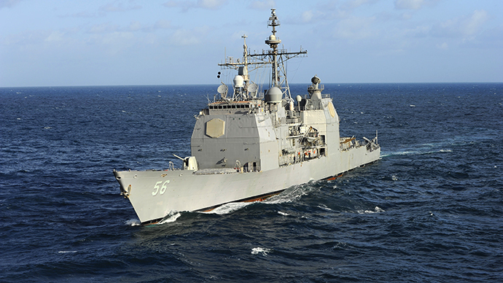
R30 Division
Combat Systems Readiness Division
Vision
Ensure that our systems remain effective, ready, supported and last their
full design life.
Technical Capabilities
DD35 – Integrated Surface Combat Control Systems Support
DD37 – Radar Distribution Systems
Key Functional Capabilities
Customer Summary
Fleet Readiness
In-Service Engineering
Shipboard Alterations and Installations
Acquisition Engineering
Integrated Logistics Support
Configuration Management
PEO IWS 1 – Readiness, TECR, Enterprise CM, CDS/CPS, ASDS, DDS, SPA-25H
PEO IWS 10 – SSDS MK 2, ACDS, TECR
PEO Ships/PMS 400D – DDG51 New Construction (DDS/SPA-25H)
PEO Ships/PMS 400F – AEGIS Modernization (DDS/SPA-25H)
PEO Ships/PMS 326 – International Fleet Support
PEO LCS, PMS420, PMS505 – LCS ASW Mission Package Logistics
PEO IWS 5B – Surface Ship ASW (AN/SQQ-89)

Slide 10
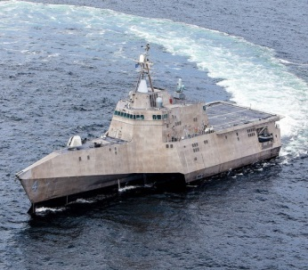

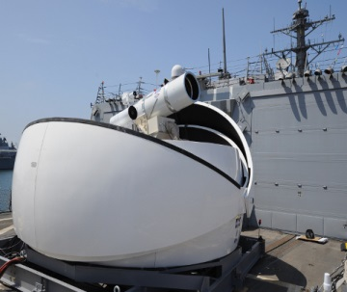
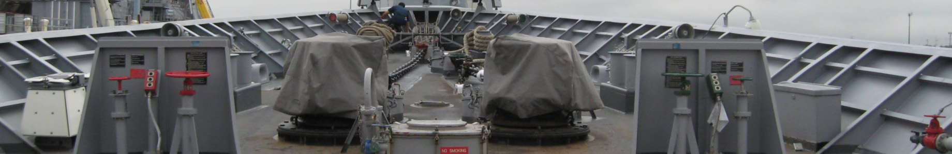
R40 Division
Systems Safety Engineering Division
Vision
To strengthen our emphasis on innovation, technical
excellence, and the quality of our products.
Technical Capabilities
DD18 – Surface Warfare Systems Safety
Customer Summary
PEO IWS 1 – BFTT, AEGIS, P&FCO
MDA – Aegis BMD, SM -3, AEGIS Ashore
PEO IWS 10 – SSDS MK 2
PEO LCS, PMS420, PMS 501,PMS505 – LCS Seaframes, SUW Mission Package, ASW Mission Package
PEO IWS 5B – Surface Ship ASW (AN/SQQ-89)
PEO IWS 2 – SM-2, ESSM, PC Griffin, SLQ-32, NULKA, AMDR, DBR, SPQ9,EASR
PEO IWS 3 – MK41 VLS, CIWS, MK34 GWS, MK48 GWS, MK46 GWS, NSSMS, RAM, MK57 VLS
PEO IWS 4 – FMS
PEO IWS 6 – CEC
PEO Carriers – CVN78
ONR – 30
PMS 312 – P&FCO
PMS 317 – LPD 17
PMS 377 – LHA, SSC
PMS 385 – JHSV, MLP AFSB
PMS 470 – P&FCO
PMA-280 TTWCS
PEO IWS 9 – DDG1000 CS
PMS 408 – CREW Systems
MCSC PM Ammo – SCSG
MCSC PM IWS – 81mm Mortars, MPM-NLWS, OI
MCSC PM A FSS – CLRF, EFSS, HIMARS, Excalibur, PERM, GMLRS
MCSC PM LAV – LAV-AT MOD, LAV FOVs
PEO-LS – GATOR
MCSC – Marine Radars
NAVSEA 04N – Laser Safety
Coast Guard – P&FCO
Key Functional Capabilities
Weapon Systems Safety Engineering
Combat Systems Safety Engineering
Platform Systems Safety Engineering
Laser Systems Safety Engineering
Pointing and Firing Cutout Zone analysis and design expertise
Radar Systems Safety Engineering
Environmental Safety Engineering
New technologies Safety Engineering

Slide 11

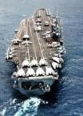
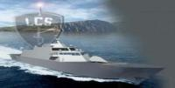
Cybersecurity Engineering
Description
Supporting Naval Programs and Platforms Throughout the Lifecycle for Engineering of Secure Systems
Security Engineering
Leadership & Support for Certification & Accreditation (C&A) Process:
    DoD Information Assurance Certification and Accreditation Process (DIACAP)
    Security Test & Evaluation Planning & Execution
    Penetration Test Planning & Execution
    Risk Assessments
    Review & Selection of Common Criteria tools
    Information Assurance Vulnerability Management (IAVM) Planning & Oversight
Risk Analysis & Management
Distributed Cyber Test & Training
Systems & Platforms
Maritime Sensors
Carrier Warfare Systems
Maritime Training Systems
Amphibious Warfare Systems
Common Architecture System Assurance (CASA)
Test Resource Management Center Cyberspace Support Cell

Slide 12

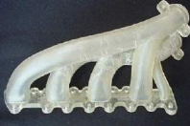

Rapid Engineering & Additive Manufacturing
Description
Rapidly develop system components able to meet robust characteristics - hostile environment within size, weight, power, & low cost constraints following disciplined engineering processes.
Harsh Environment Laboratory (HEL)
Additive Manufacturing / 3D Printing
What Can Be Printed?
Navy Additive Manufacturing Innovation
  Family of processes that join materials together in order to create objects from 3D data models, layer upon layer…as opposed to traditional subtractive processes, e.g., machining
    Applications
        Rapid Prototyping, Tooling, Molding, Repair, Custom Parts, Prosthesis, Cranial Implants, Surgical Planning, Warfighting Systems
    Communities
        Aviation, Ship, Sub, Medical, Applied Research
Chief of Naval Operations’ Rapid Innovation Cell (CRIC)
    “Print-to-Fleet” Initiative
Materials
Metals
Polymer
Paper
Ceramic

Slide 13
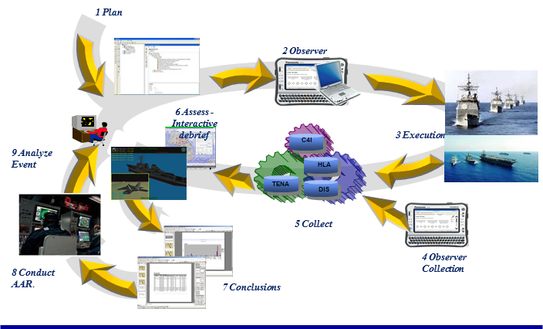
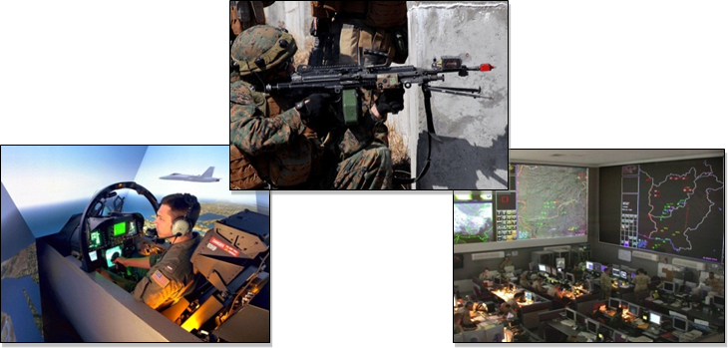
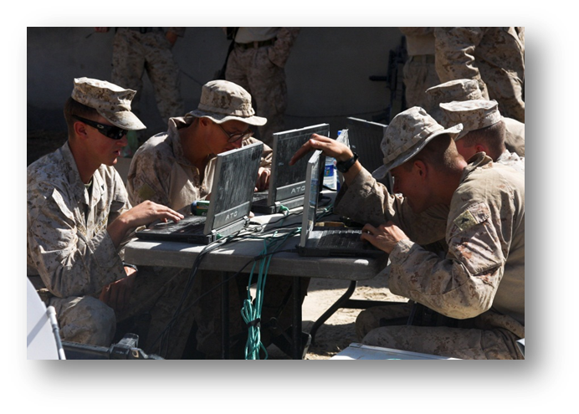
Integrated Training Systems
Description
Supporting Warfighters Across the Training Continuum through Collaboration, Teamwork & Technical Expertise
Individual, Team, Units, Strike-Group, Joint
Embedded Shipboard Training
Modeling & Simulation Services
Communication Architectures
Fleet Synthetic Training
    M&S Development
    FST Exercise Integration
    Distributed Training Environment
Maritime, Joint & Multi-National Exercise Integration
    Joint Live Virtual Constructive
Web Enabled Individual Training
The Training Continuum

Slide 14
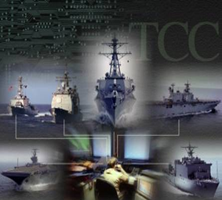
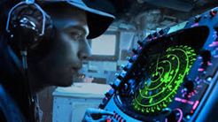
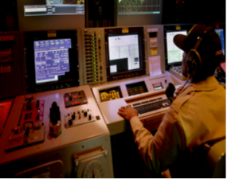

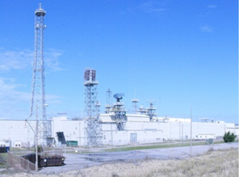
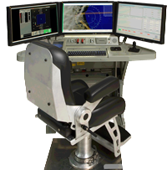
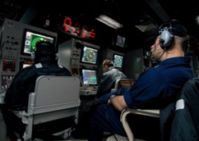
Surface Warfare Systems
Description
Supporting Surface Warfare Systems Hardware & Software Design, Acquisition, Logistics, Test & Delivery and Life Cycle Engineering.
In-Service Engineering
Fleet Readiness & Support
Systems Acquisition Engineering
Alterations, Installations & Grooms
Combat Systems Integrated Logistics
System Modernization & Obsolescence Engineering
Systems & Platforms
Carrier Warfare Systems
Surface Undersea Sensors
Amphibious Warfare Systems
Common Computing & Displays
Surface Sensor Distribution Systems

Slide 15
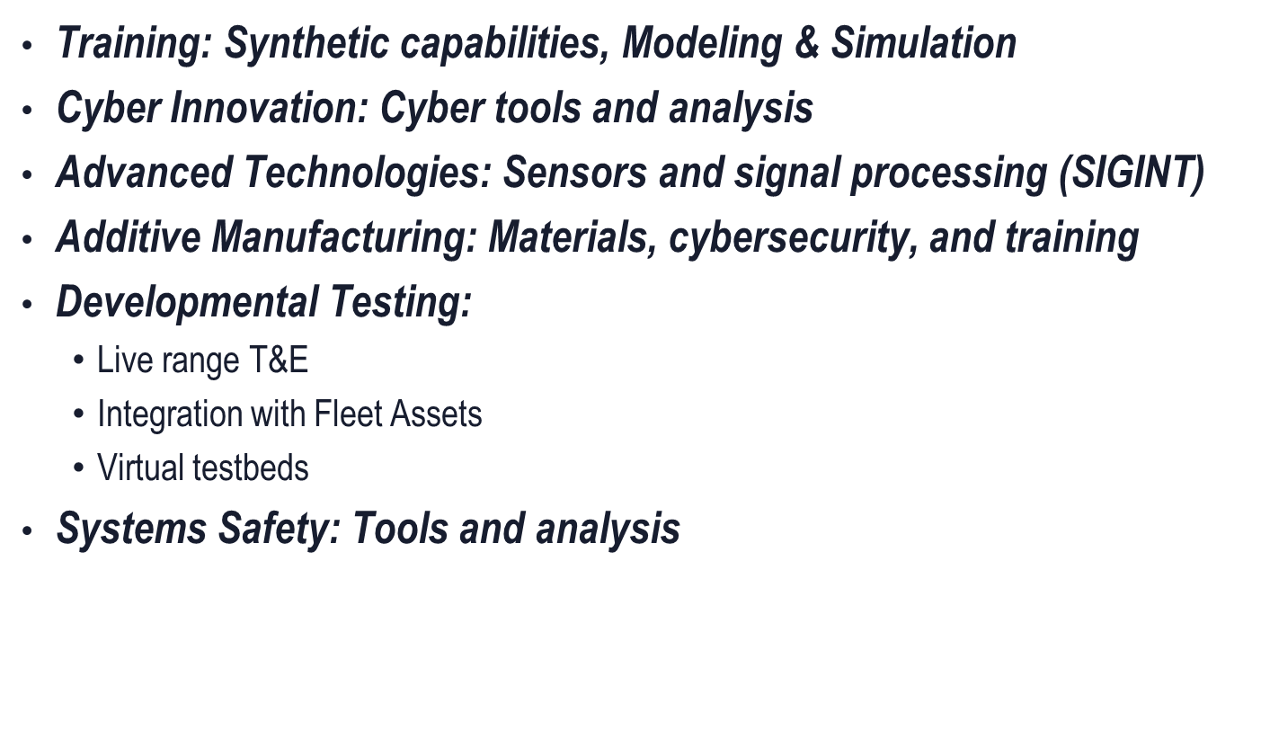
Cross-Site Business Thrusts

Slide 16
Types of Support Contracts
Structured by Functional Area
            Cyber Engineering Services
            Hardware Procurements
            Systems Engineering Services
            Hardware Engineering Services
            In-Service Engineering Services
            Original Equipment Manufacturer Support
            Software Services
            Systems Safety Engineering Services

Slide 17
Future Contracts
      Engineering and Subject Matter Expert Support Services
      SPQ-14 & 15 Hardware & Support
      Global Training and Readiness Support
      Fleet Delivery and Install Support
      Surface Sonar's Life Cycle Engineering Support
      Training and Readiness Software Development Support
      Training and Readiness Systems Engineering Support
      ITS ISEA Install Support
      SSDS Production
      Prototype & EDM Engineering
      System Safety
      Programmatic and Acquisition Support Services
      Combat Systems Engineering
      Software Engineering Support
      Signal Intelligence (SIGINT)
Planned 2017/18 Support Requirements Solicitation Areas

Slide 18
Questions?

