Slide 1
Doing Business With The Department of the Navy TGIC Exchange Brief
November 10, 2016

Slide 2
Department of the Navy
Small Business Enterprise Strategic Framework
VISION
To influence change and create a culture of small business inclusiveness across the Department of the Navy.
MISSION
The DON Small Business Enterprise fosters acquisition opportunities where small businesses can best support Sailors, Marines, and their families through policy, advocacy, counseling & training.
Motto
“Small Business – The First Option”
Foster a DON-wide culture that meets the challenges of tomorrow by leveraging Small Business as a strategic advantage
Strategy
Focus Areas
Professional Workforce Development | Build Partnerships in the Acquisition Process | Optimize Communications
Leadership
Professionalism
Integrity
Customer Focus
Advocacy
Innovation
Values

Slide 3
Small Business Performance

Slide 4
Fiscal Year 2015
Portfolio Group Performance
Portfolio Group | OTSB $ | SB $ | Total $ | SB %
Aircraft, Ships, & Land Vehicles | $17,350,905,533 | $80,217,072 | $17,431,122,605 | 0.46%
Knowledge Based Services | $4,501,296,241 | $2,697,604,717 | $7,198,900,959 | 37.47%
Research and Development | $5,110,810,616 | $1,137,495,682 | $6,248,306,298 | 18.20%
Electronic & Communication Equipment | $4,817,378,461 | $1,088,219,224 | $5,905,597,686 | 18.43%
Sustainment S&E | $4,716,106,732 | $584,445,204 | $5,300,551,937 | 11.03%
Equipment Related Services | $4,143,189,407 | $848,562,663 | $4,991,752,071 | 17.00%
Facility Related Services | $2,106,427,515 | $2,571,353,012 | $4,677,780,527 | 54.97%
Weapons & Ammunition | $4,232,031,431 | $124,182,180 | $4,356,213,612 | 2.85%
Electronic & Communication Services | $2,727,795,572 | $881,790,970 | $3,609,586,542 | 24.43%
Construction Services | $1,382,171,074 | $610,170,716 | $1,992,341,790 | 30.63%
Facilities S&E | $619,653,749 | $444,945,692 | $1,064,599,441 | 41.79%
Transportation Services | $536,373,707 | $463,556,264 | $999,929,971 | 46.36%
Logistics Management Services | $235,287,335 | $181,457,160 | $416,744,495 | 43.54%
Medical Services | $5,978,862 | $337,742,436 | $343,721,298 | 98.26%
Clothing, Textiles & Subsistence S&E | $104,699,559 | $90,004,735 | $194,704,294 | 46.23%
Grand Total | $52,590,105,796 | $12,141,747,728 | $64,731,853,525 | 18.76%

Slide 5
Fiscal Year 2015
Top 10 Overall NAICS
NAICS | Description | Total Awards
336611 | SHIP BUILDING AND REPAIRING | $13,369,654,625
541330 | ENGINEERING SERVICES | $10,644,109,729
336411 | AIRCRAFT MANUFACTURING | $6,819,830,548
541712 | RESEARCH AND DEVELOPMENT IN THE PHYSICAL, ENGINEERING, AND LIFE SCIENCES (EXCEPT BIOTECHNOLOGY) | $4,053,205,694
334511 | SEARCH, DETECTION, NAVIGATION, GUIDANCE, AERONAUTICAL, AND NAUTICAL SYSTEM AND INSTRUMENT MANUFACTURING | $3,937,933,342
236220 | COMMERCIAL AND INSTITUTIONAL BUILDING CONSTRUCTION | $2,337,268,179
336413 | OTHER AIRCRAFT PARTS AND AUXILIARY EQUIPMENT MANUFACTURING | $2,254,855,477
336414 | GUIDED MISSILE AND SPACE VEHICLE MANUFACTURING | $2,060,637,378
332410 | POWER BOILER AND HEAT EXCHANGER MANUFACTURING | $1,566,370,151
336412 | AIRCRAFT ENGINE AND ENGINE PARTS MANUFACTURING | $1,204,379,441

Slide 6
Fiscal Year 2015
Top 10 Small Business NAICS
NAICS | Description | SB Awards
541330 | ENGINEERING SERVICES * | $2,803,312,441
236220 | COMMERCIAL AND INSTITUTIONAL BUILDING CONSTRUCTION * | $1,346,924,313
541712 | RESEARCH AND DEVELOPMENT IN THE PHYSICAL, ENGINEERING, AND LIFE SCIENCES (EXCEPT BIOTECHNOLOGY) * | $834,701,182
336611 | SHIP BUILDING AND REPAIRING * | $756,002,762
561210 | FACILITIES SUPPORT SERVICES | $508,186,073
483111 | DEEP SEA FREIGHT TRANSPORTATION | $373,550,726
541519 | OTHER COMPUTER RELATED SERVICES | $255,321,071
622110 | GENERAL MEDICAL AND SURGICAL HOSPITALS | $236,024,526
334220 | RADIO AND TELEVISION BROADCASTING AND WIRELESS COMMUNICATIONS EQUIPMENT MANUFACTURING | $229,118,811
334111 | ELECTRONIC COMPUTER MANUFACTURING | $161,837,094
* Indicates also Top 10 Overall NAICS

Slide 7
Doing Business
Naval Supply Systems Command (NAVSUP) 717-605-1663 | Majority of Navy buys Services, material, logistics, maritime, aviation spares
Naval Sea Systems Command (NAVSEA) 202-781-3965 | Shipbuilding
Naval Air Systems Command (NAVAIR) 301-757-9044 | Aviation
Space and Naval Warfare Systems Command (SPAWAR) 858-537-0305 | Information Technology / Communications
U.S. Marine Corps Installations and Logistics (HQMC I&L) 703-604-4219 | Ground Equipment
Marine Corps Systems Command (MARCORSYCOM) 703-432-3946 | Ground Weapons and IT Systems
Office of Naval Research (ONR) 703-696-2607 | R&D (SBIR)
Military Sealift Command (MSC) 757-443-2717 | Ocean Transportation
Strategic Systems Programs (SSP) 202-433-7857 | Strategic Weapons Systems (Missile Systems)
Naval Facilities Engineering Command (NAVFAC) 202-685-9129 | Construction & Facilities

Slide 8
Doing Business
Key Players
Contracting Officer
Deputy Program Manager (If support to major program)
Small Business Professional
Procurement Center Representative (PCR)

Slide 9
Doing Business
Engagement
Identify customers/potential opportunities
PTAC Bid match/LRAF/Pre-solicitation (fbo.gov)/other
Respond to Sources Sought/RFI’s
Share information with other Small Businesses
Same industry/socio-economic categories
Encourage others to engage
Contact contracting activity/program office
Small Business Professional
I have responded to pre-solicitation (x)/I have found
requirement (z) in your LRAF and would like to see it set-aside for….
How do they buy what you sale?
How are requirements between $3K and $25K solicited?
Where can you get a list of primes that they typically do business with?

Slide 10
Doing Business

Slide 11
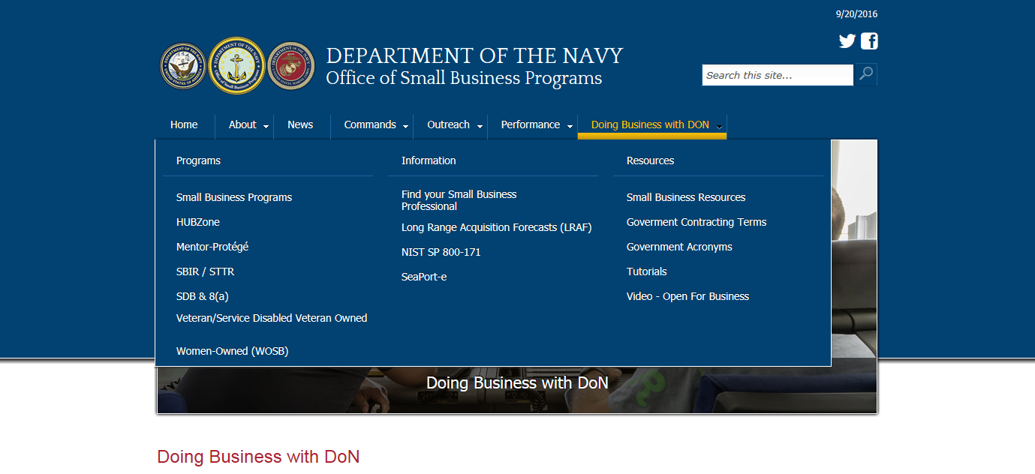
Doing Business

Slide 12
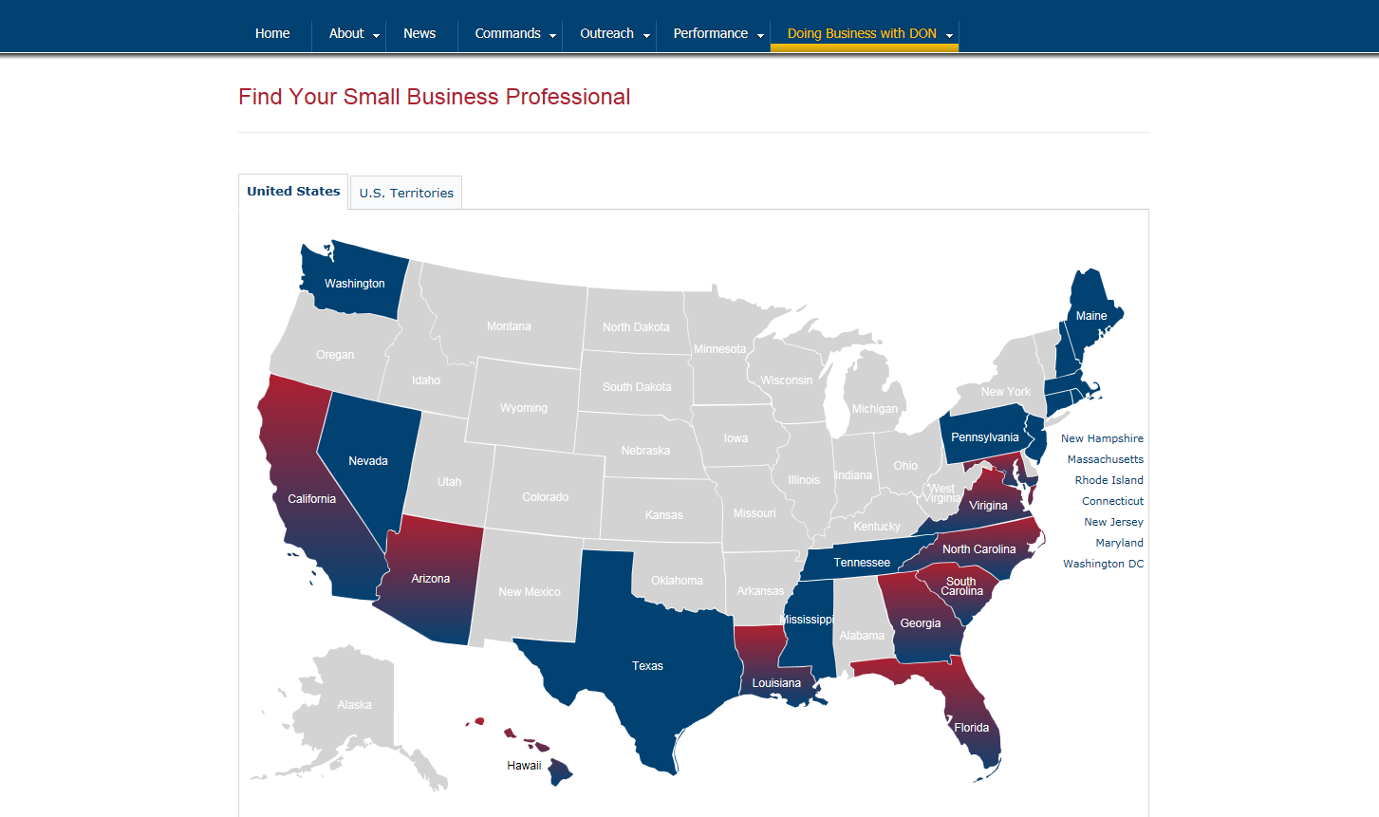
Doing Business

Slide 13
Doing Business
Command | Organization | City | Point of Contact
USMC I&L | U.S. Marine Corps Headquarters | Arlington | Mr. Stanley C. Daise
USMC I&L | Marine Corps Base Quantico | Quantico | Ms. Leslie Perry
USMC I&L | Marine Corps Forces Command | Norfolk | Ms. Leslie Perry
ONR | Office of Naval Research | Arlington | Ms. Brenda Pickett
NAVSUP | Navy Exchange Service Command | Virginia Beach | Mr. Tim Barden
NAVSUP | Naval Medical Center, Portsmouth | Portsmouth | Ms. Juliann Krogh
NAVSUP | Fleet Logistics Center, Norfolk | Norfolk | Ms. Leah Baker
NAVSEA | Naval Surface Warfare Center | Dahlgren | Mr. Kristofer E. Parker
NAVSEA | Norfolk Ship Support Activity (NSSA) | Portsmouth | Ms. Beverly Darden
NAVSEA | Supervisor of Shipbuilding, Conversion & Repair | Newport News | Ms. Joyce S. Williams
NAVSEA | Norfolk Ship Support Activity (NSSA) | Portsmouth | Ms. Lyn Sylvest
NAVFAC | Naval Facilities Engineering Command Mid-Atlantic | Norfolk | Mr. Joseph McGrenra
NAVFAC | Naval Facilities Engineering Command Atlantic | Norfolk | Ms. Cynthia Anderson
NAVFAC | Naval Facilities Engineering Command Washington | Dahlgren | Ms. Debbie San-Luis

Slide 14
FY17 Navy Small Business
Events
3-5 Apr Sea Air Space Small Business Symposium National Harbor, MD
3-5 Apr DON Forum For SBIR/STTR Transition National Harbor, MD
22-23 Aug Navy Gold Coast Small Business Forum San Diego, CA

Slide 15
Additional Info
Procurement Technical Assistance Centers (PTAC)
http://www.aptac-us.org/find-a-ptac/
Federal Procurement Data System-Next Generation(FPDS-NG)
https://www.fpds.gov/
Navy Electronic Commerce (NECO)
https://www.neco.navy.mil

