Slide 1
Deputy Competition
Advocate/Director, Office
Of Small Business Programs
(OSBP)
TGIC BRIEF
NOVEMBER 10, 2016
DCA/Director, OSBP, Code 00K
Naval Undersea Warfare Center, Division Newport
DISTRIBUTION STATEMENT A; Approved for Public Release: distribution is unlimited

Slide 2
COMPETITION INITIATIVES
Extensive Strategy Sessions, and buy-in (all Stakeholders) at the very earliest stages of the procurement process
Competition
Small Business Participation
Release of Advanced Notices (i.e. "fair warning”)
Release of Draft SOW’s
Utilization of Sources Sought
Promulgation of a 2-year Long Range Acquisition Forecast (LRAF)
updated and released quarterly
Utilization of Social Media: OSBP LinkedIn, DIVNPT LinkedIn
Continual communication (i.e. “drumbeat) of the results of our efforts to increase competition and small business participation
Success stories encourage companies to engage in the market

Slide 3
COMPETITION INITIATIVES (CON’T)
Development and Maintenance of the DIVNPT “Business Partnerships” website:
http://www.navsea.navy.mil/Home/WarfareCenters/NUWCNewport/Partnerships/BusinessPartnerships.aspx
Link to: OSBP website
Metrics, other WFC Small Business POC’s, Visit Request info
Link to: Electronic Reading Room (ERR)
“DIVNPT Resource Sheet”
“Competition Information”
LRAF (with contact info), Industry Day Presentations, Pre-Solicitation Conference Slides, Small Business Roundtable (SBRT) briefings, etc.
“SeaPort-e Council”
Biannual Meeting Minutes/Q&A

Slide 4
COMPETITION INITIATIVES (CON’T)
Host 10+ Industry Outreach Events per year, including:
Pre-Solicitation Conferences and Facility Tours: to discuss the specific technical requirements of a procurement
Industry Days:
Every 2 years (even years) to discuss overall DIVNPT procurements and technical requirements
As required to discuss Department-wide contracts portfolio
Yearly to allow SB vendors to demonstrate their products
Yearly “Small Business Matchmaker”
Semi-annual SeaPort-e Council Meetings: to communicate with and gauge Industry's view on how we are performing and how we can do better
Training:
Yearly SDVOSB/VOSB Training Event
Every 2 years (odd years) to provide training on Contracts-related issues
NUWCDIVNPT Consistently Educates,
and Engages with, Industry

Slide 5
COMPETITION INITIATIVES (CON’T)
Interaction with Local Trade Groups and Agencies
RI Chapter of the National Contract Management Association (NCMA)
http://ncma-ri.org/contact-us/
http://ncma-ri.org/list-companies/
“On-Line Matchmaker”
Southeastern New England Defense Industry Alliance (SENEDIA)
http://www/senedia.org/contact-us.html/
Armed Forces Communication and Electronics Association (AFCEA)
(781) 862-2465
RI Procurement Technical Assistance Center (PTAC)
http://www.riptac.org/
URI Business Engagement Center (BEC)
http://web.uri.edu/bec/

Slide 6
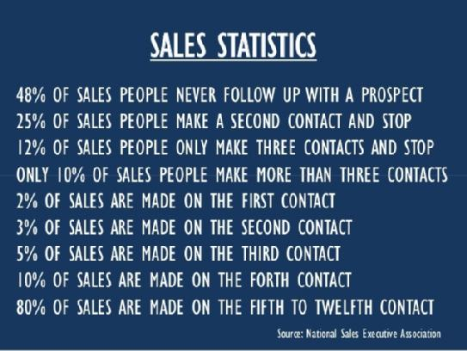
COMPETITION INITIATIVES (CON’T)
Value of the DIVNPT Outreach Events: 10+ events every year

Slide 7
GOALS AND METRICS
Competition Goals:
Increase overall competition by ensuring all companies have a fair opportunity to compete
Encourage new vendors to bid
Since FY 13:
(13) new small businesses have been awarded a Prime contract
(18) small business have been awarded additional Prime contracts
(10) large businesses have been awarded additional Prime contracts
(2) new large businesses have been awarded a Prime contract
FY 17:
Potential for (17) contracts to be awarded – at least (14) will be awarded to Small Business
Approx. $500M (ceiling value) to Small Business

Slide 8
GOALS AND METRICS (CON’T)
Competition Goals (Con’t):
Reduce/eliminate SeaPort-e RFP/Major contract responses by (1) vendor
FY 13: Received multiple offers on 83% of solicitations
FY 14: Received multiple offers on 81% of solicitations
FY 15: Received multiple offers on 89% of solicitations
FY 16: Received multiple offers on 94% of solicitations
Small Business Goals:
Achieve small business goals assigned by SEA00K
FY 13: Goal: 25%, Achieved: 37%
FY 14: Goal: 25%, Achieved: 34%
FY 15: Goal: 34%, Achieved: 39%
FY 16 (to date): Goal: 39%, Achieved: 36%
DIVNPT Competition Initiatives Facilitate
Entry into the Market, and Increase Small Business Participation

Slide 9
GOALS AND METRICS (CON’T)
Overall Keys to Success:
Extensive Strategy Sessions conducted at the earliest phases of the procurement process
Awarded work is getting outside of the typical “swim-lane” of small business
Complete support and advocacy from Contracts Department, Office of Counsel, Technical and Business Departments, and NUWCDIVNPT Leadership
Early, consistent communication with Industry
Viable and capable small businesses, strong teaming

Slide 10
CONCLUSION
DIVNPT has implemented a successful and comprehensive program to encourage, ensure and increase competition and small business participation
DIVNPT is a vibrant and competitive environment and offers many opportunities to Prime, and/or Sub
The DIVNPT DCA/Director, OSBP is the ideal entry point for any business (large or small) that wants to do business with DIVNPT
Questions?
NUWC_NPT_OSBP@navy.mil
(401) 832-7372

